Slide 1

Bike-Sharing Rider Demand Analysis
Analyse overall rider demand.
Identify peak riding hours and high-demand periods.
Compare registered vs casual riders.
Understand the impact of weather on rider demand.
Compare weekday and weekend usage.
Identify unusual demand patterns using outlier analysis.
Provide recommendations for better operational planning.

Slide 2
Data Set Overview
Date & Time: Date, Month, Hour
Calendar: Season, Weekday, Week type, Day type
Weather: Weather Type, Temperature, Humidity, Windspeed
Rider Information: Casual, Registered, Total
Row Labels | Sum of casual | Sum of registered | Sum of Total
Jan | 155 | 1854 | 2009
Feb | 49 | 1064 | 1113
Grand Total | 204 | 2918 | 3122

Slide 3
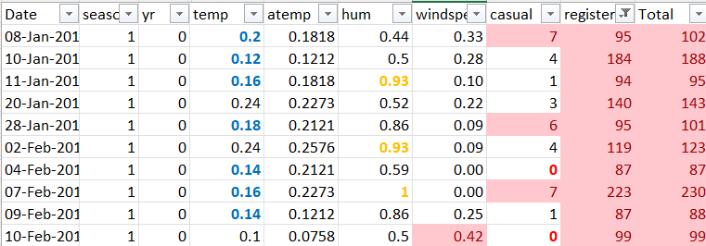
Methodlogy
Merged data set1 and data set2.
Append merged data set with data set3.
Remove duplicates, cleaned the data & created final file .
Using IFS formula converted the columns into meaning format.
Eg = IF(AND(K2>=1,K2<=5),"Weekday","Weekend")
=IFS(M2=1,"Sunny Day",M2=2,"Cloudy Day",M2=3,"Rainy
Day",M2=4,"Heavy Rain")
Done the conditional formatting for various columns.

Slide 4
Dashboard Creation
Row Labels | Sum of casual | Sum of registered | Sum of Total
Jan | 99 | 1139 | 1238
Feb | 24 | 604 | 628
Grand Total | 123 | 1743 | 1866
Row Labels | Sum of casual | Sum of registered | Sum of Total
Cloudy Day | 81 | 1175 | 1256
Heavy Rain | 1 | 35 | 36
Rainy Day | 23 | 497 | 520
Sunny Day | 99 | 1211 | 1310
Grand Total | 204 | 2918 | 3122
Row Labels | Sum of Total
Holiday | 1387
Workday | 1735
Grand Total | 3122

Slide 5
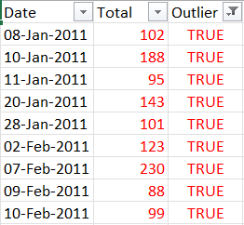
Anomaly Detection
Used the IQR method:
IQR = Q3 − Q1
Upper Bound = Q3 + 1.5 × IQR
Lower Bound = Q1 − 1.5 × IQR
=OR(T19>$Y$2,T19<$Z$2)

Slide 6
Demand Forecasting
Historical demand should be used to forecast future rider requirements.
Demand forecasting for future days with respect to casual and registered riders given below.

Slide 7
Key Findings
Rider Demand Is Strongly Time-Dependent
Morning commuting hours can create significant demand pressure.
For example, several high-demand observations occur during conventional commuting periods:
10-Jan at 08:00: 188 riders
20-Jan at 09:00: 143 riders
07-Feb at 08:00: 230 riders
Evening demand is also visible in the dataset. For example:
11-Jan at 18:00: 95 riders
09-Feb at 19:00: 88 riders
Therefore, demand planning should pay particular attention to both morning and evening peak periods.

Slide 8
Key Findings (Continue)
Registered riders are an important source of demand.
Casual riders generally represent a smaller proportion of demand in several high-demand observations.
Weather (sunny, cloudy, rainy, and heavy-rain conditions) may influence rider demand.
Peak demand can create operational pressure .
Outliers (Anomaly) can provide business insights :Outlier analysis can be useful for understanding exceptional demand.

Slide 9
Recommendations
Improve Peak-Hour Bike Availability : Bike availability should be increased before anticipated peak periods, particularly during morning commuting hours.
Prioritize Registered Rider Demand :Membership data can also be used to understand recurring travel patterns and improve demand predictions.
Develop Weather-Aware Operations : Weather forecasts can be incorporated into daily operational planning.
Target Casual Riders Strategically: Casual riders may respond differently to registered users. Various ways are:
Weekend promotions
Seasonal campaigns
Weather-sensitive offers
First-ride discounts

